Slide 1
The Internet Landscape in the Middle East
RPKI deployment and IPv6 uptake in the region
Jad el Cham| RIPE NCC | 4 December 2024
Notes:
Focus on the arabic-speaking countries of the region

Slide 2
Routing Security

Slide 3
Enhancing Routing Security with RPKI
RPKI provides a cryptographic framework for verifying routing announcements, currently through the use of two main key components
Route Origin Authorisation (ROA): Defines which ASes are authorised to announce specific IP prefixes
Route Origin Validation (ROV): Validates routes based on ROAs, ensuring only legitimate routes are accepted.

Slide 4
Route Origin Authorisation

Slide 5
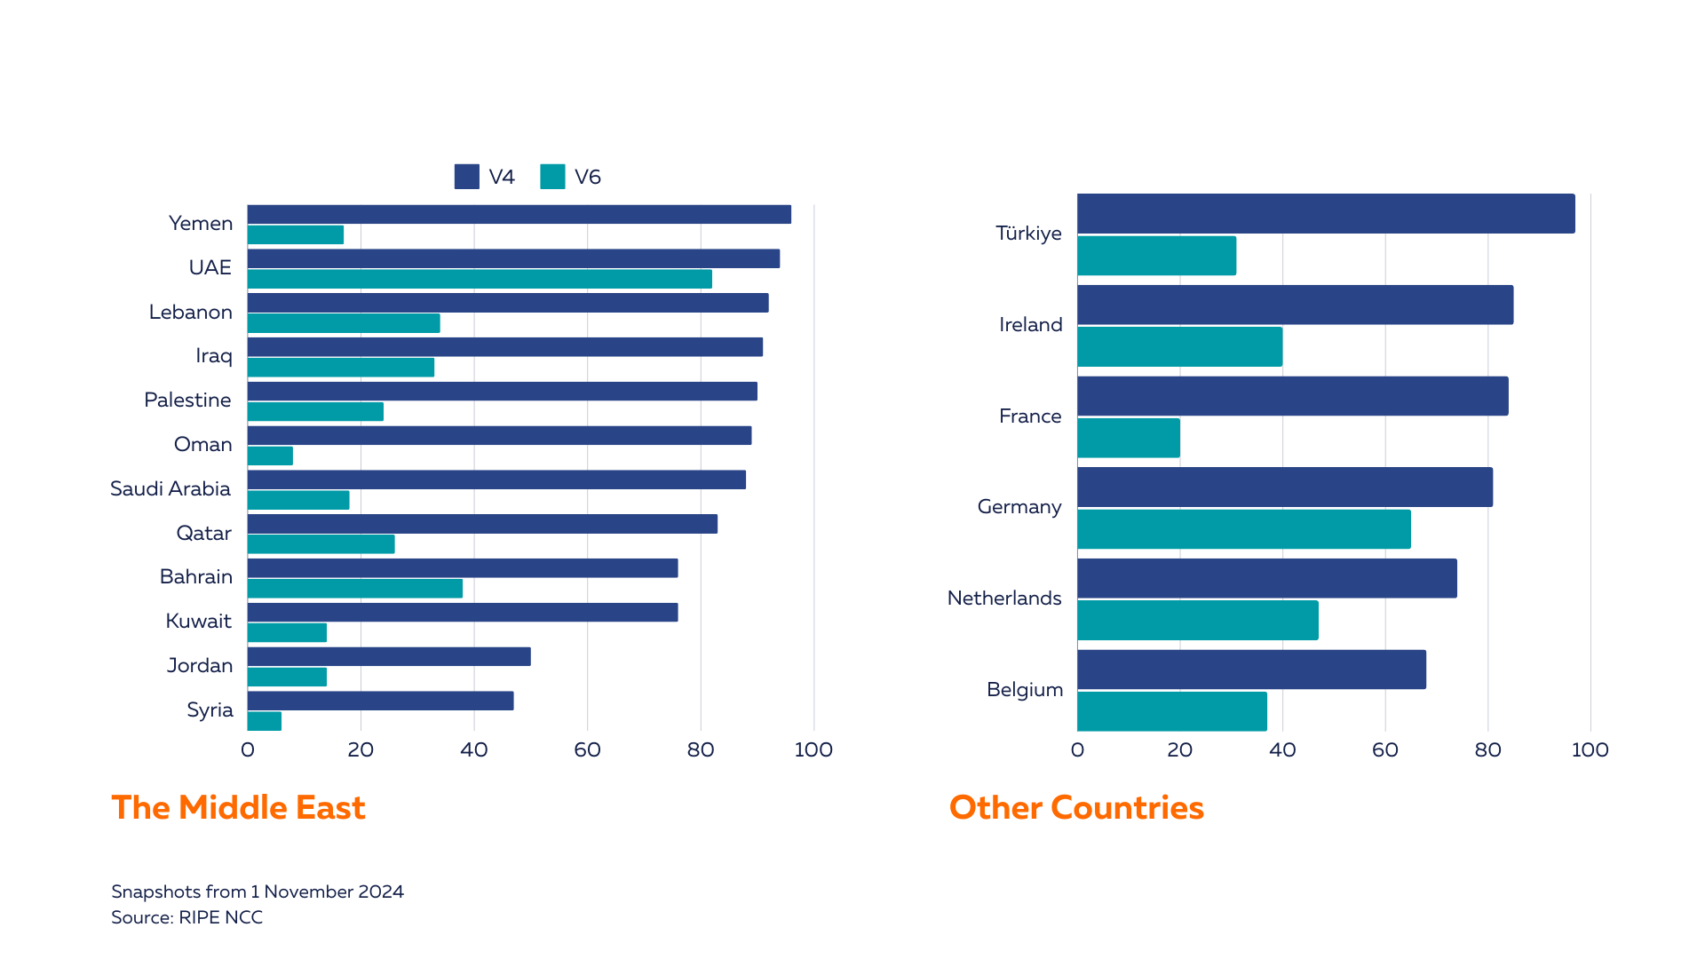
ROA Coverage in the region (IPv4 and IPv6)

Slide 6
ROA Coverage in the region (IPv4)

Slide 7
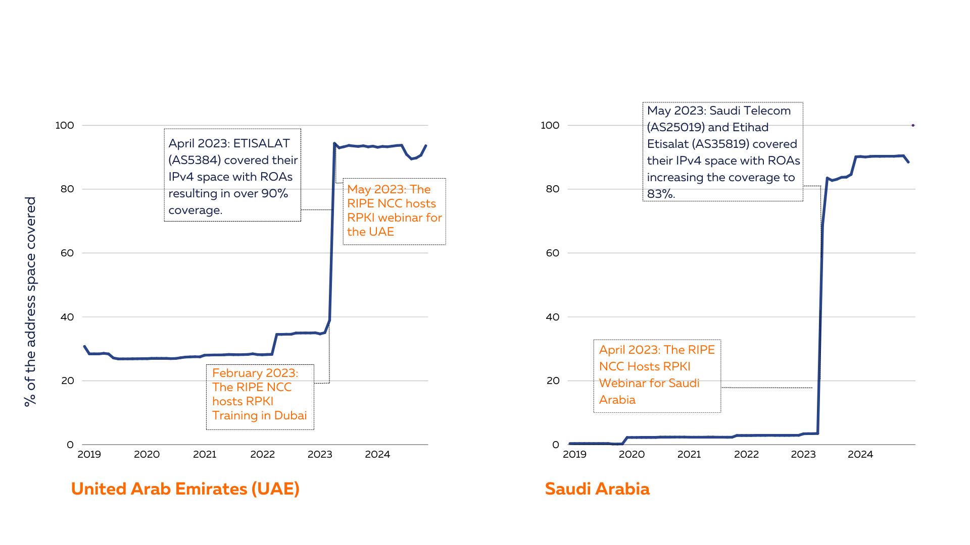
ROA Coverage in the region (IPv4)

Slide 8
Route Origin Validation

Slide 9
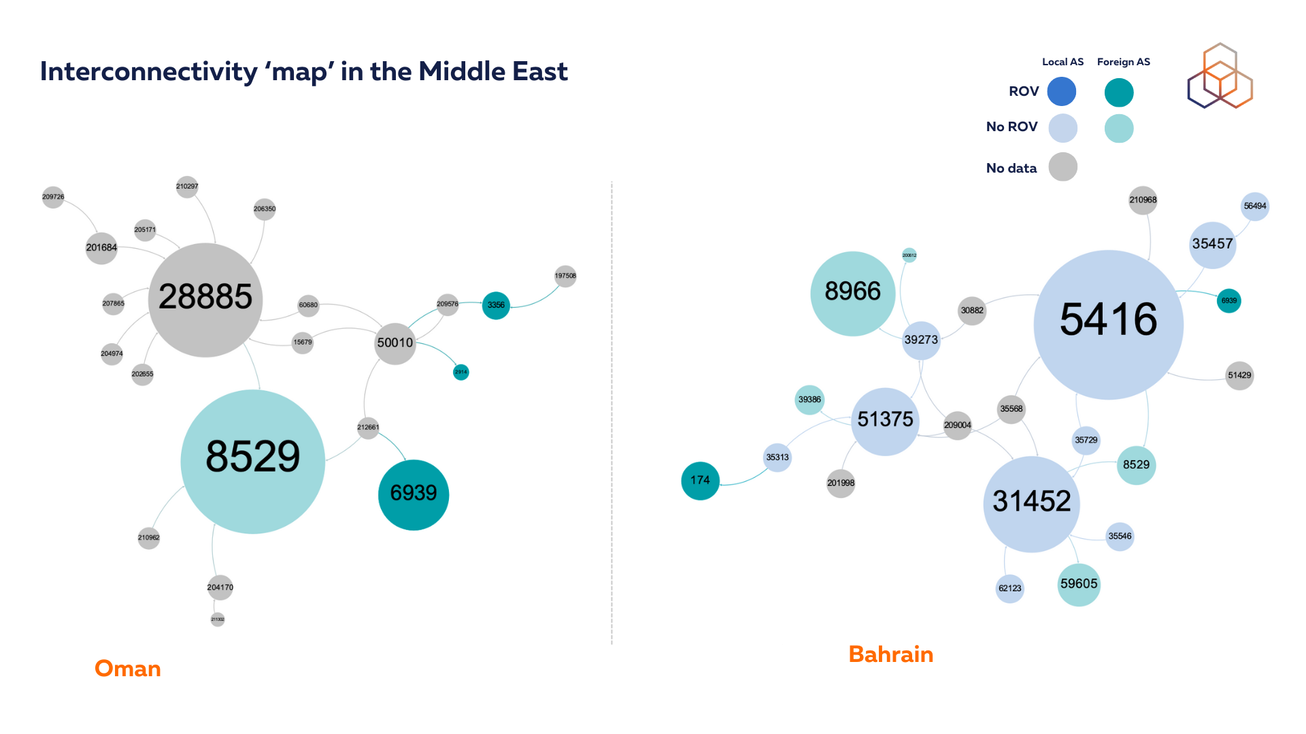

Slide 10
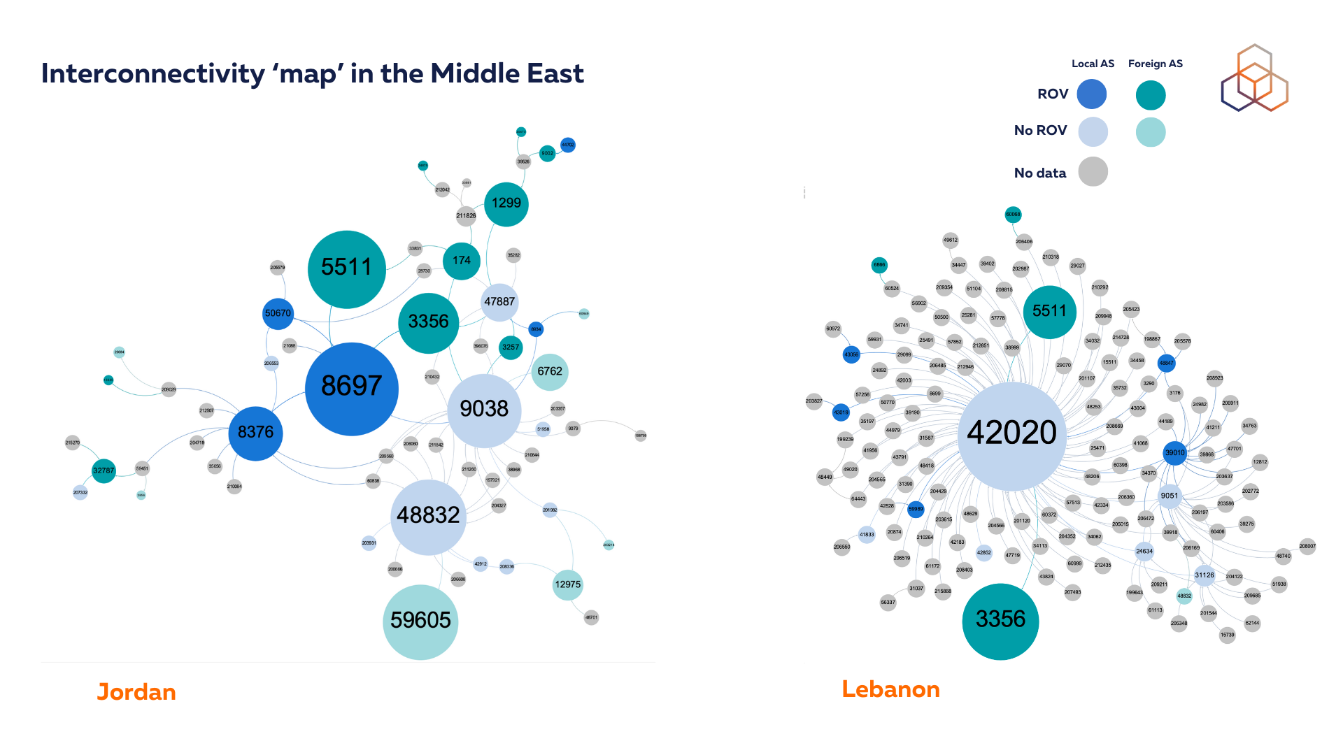

Slide 11
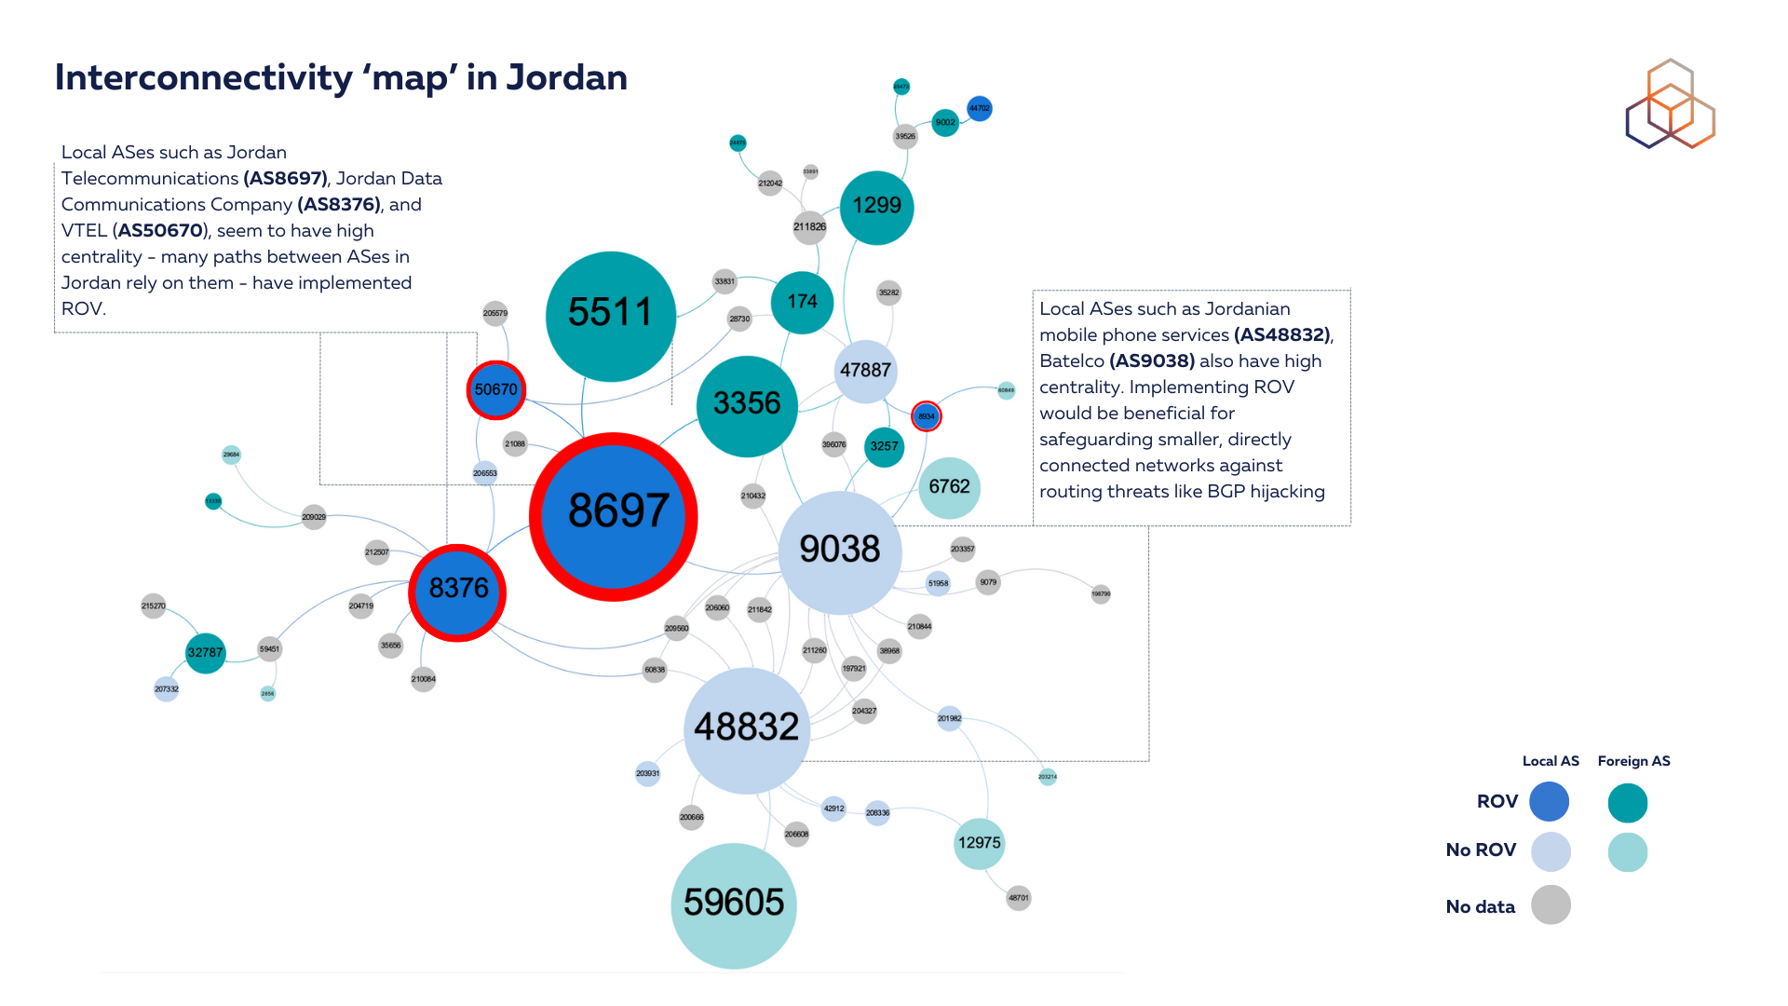

Slide 12
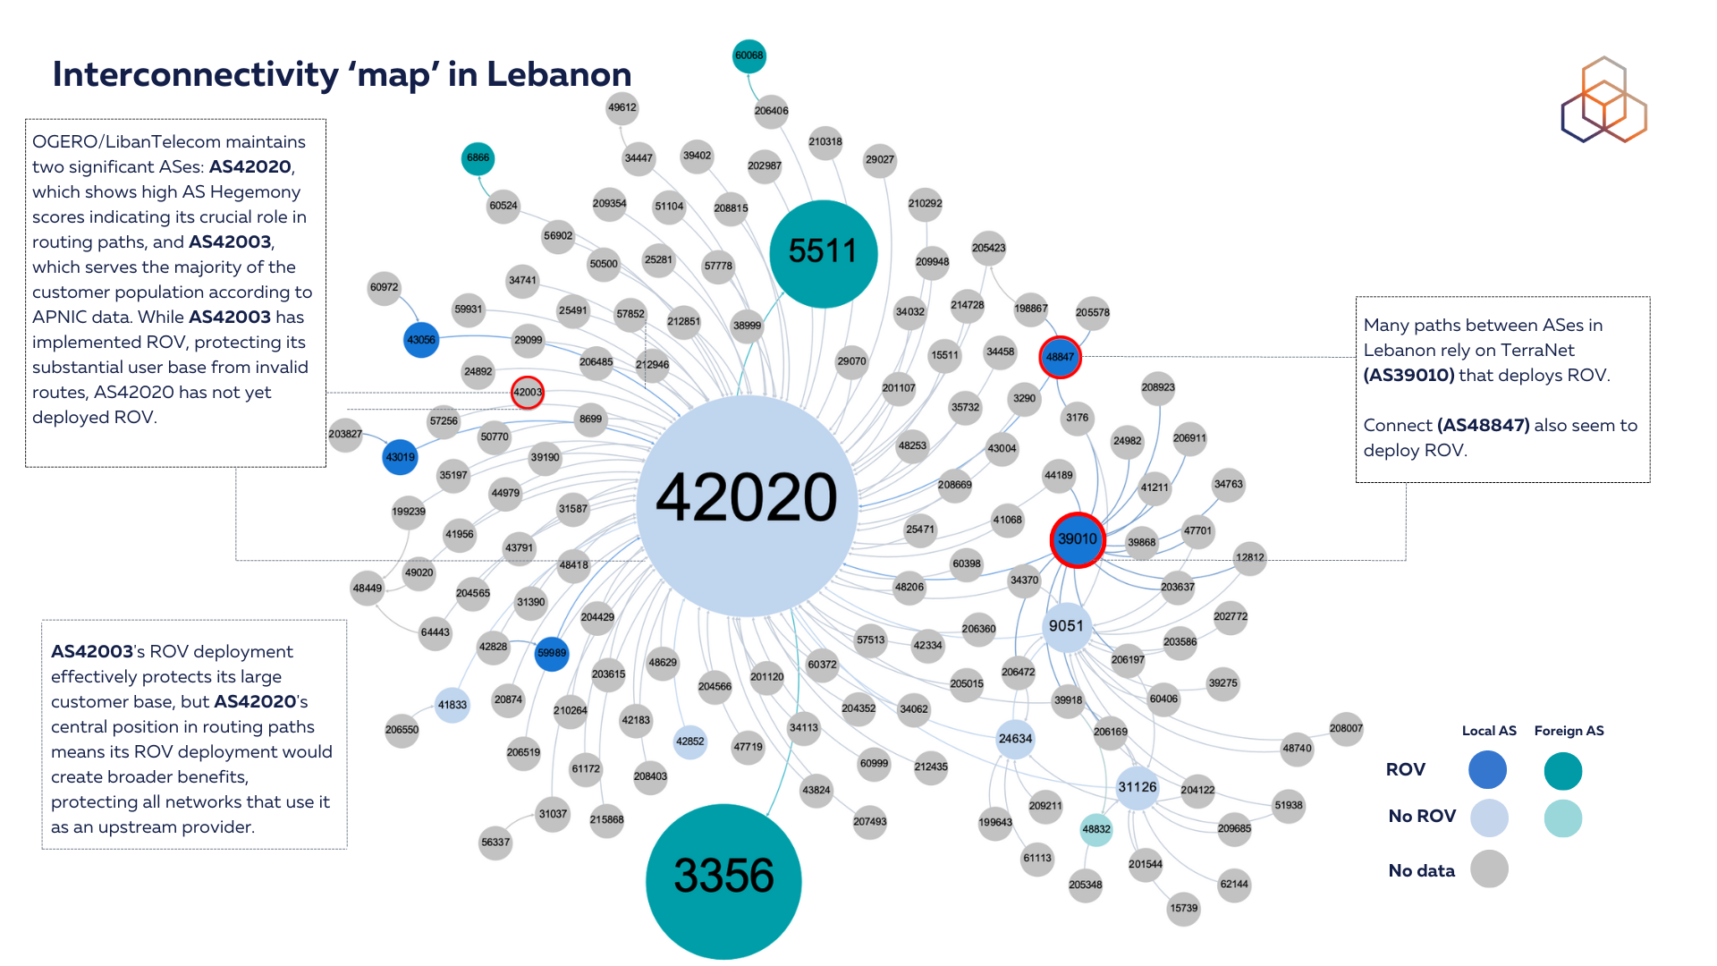

Slide 13
IPv6 Uptake in the Middle East

Slide 14
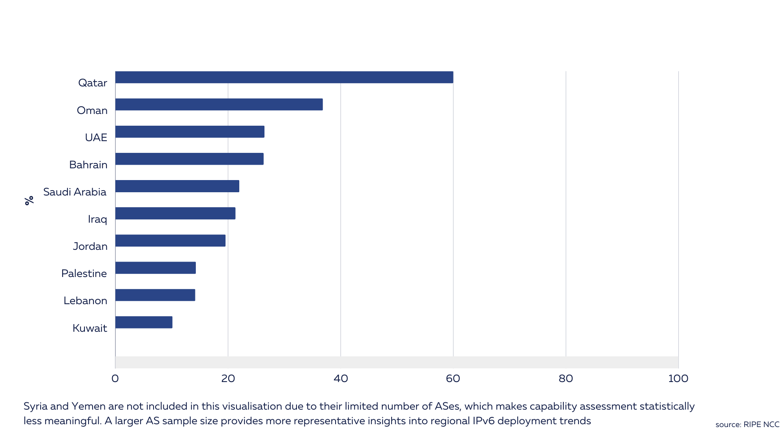
% of IPv6-capable ASNs in the Middle East

Slide 15
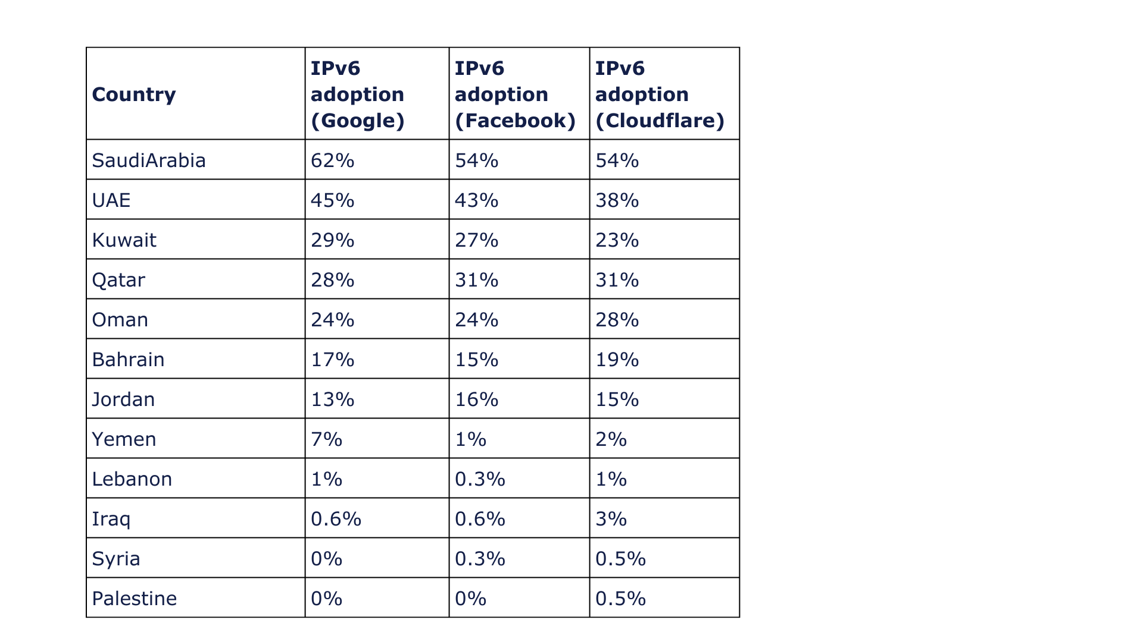
IPv6 Adoption in the Middle East
IPv6 adoption measures if users can actually use IPv6 on their networks.
We used Content Delivery network (CDN’s) (Google, Facebook, Cloudflare) traffic statistics to measure adoption across the region.
Promising level of IPv6 adoption in the region. Saudi Arabia emerges as a regional and global leader. The United Arab Emirates follows with over 40% IPv6 adoption.
Notes:
Stats november 2024

Slide 16
Interested? Read the Full Report on RIPE Labs
labs.ripe.net/author/qasim-lone/the-internet-landscape-in-the-middle-east/

Slide 17
?
Questions & Comments
jelcham@ripe.net

Slide 18
Measuring ROV
We used RoVISTA to analyse deployment of ROV across the Middle East region
RoVISTA calculates the scores based on the number of RPKI-invalid prefixes that an AS can reach. We used a more inclusive approach where we classify an AS as having implemented ROV if its score is greater than 0, indicating any level of ROV deployment.
Collateral benefit
We assessed ROV impact from the perspective of network centrality, utilising the AS Hegemony 2 methodology, which measures the centrality of autonomous systems within a country.
The methodology measures the common transit networks to a local AS and how much this AS relies on these transit networks based on BGP data. AS hegemony values range between 0 and 1 and indicate the fraction of paths crossing a node.

Slide 19
IPv6 Capability
Given the vast size of the IPv6 address space, counting individual addresses is not an effective metric.
We calculated (IPv6 capability) the percentage of ASes in each country that announce both IPv4 and IPv6 addresses, as well as those that announce only IPv6, compared to those that announce only IPv4
IPv6 capability indicates that addresses are being routed, this does not necessarily equate to adoption.
IPv6 capability should be viewed as an initial step toward broader adoption.

